Slide 1
Mapping Student Solution Rubric Categories to Faculty Perceptions
Andrew J. Mason¹, Brita Nellermoe^{1,2}
¹Physics Education Research and Development
University of Minnesota, Twin Cities, Minneapolis, MN
²University of St. Thomas, St. Paul, MN
AAPT Winter Meeting, Jacksonville, FL
January 11, 2011

Slide 2
Background (both of these were NSF-funded)
Faculty Interviews – Perceptions about Problem Solving
(Yerushalmi, Henderson et al. 2007)
Rubric for Analysis of Student Problem Solving
(Docktor, 2009)
Develop a rubric for assessing written student problem solutions according to a set of problem solving categories
- Useful Description
- Physics Approach
- Specific Application
- Math Procedure
- Logical Progression
Validity, reliability, utility extensively tested
Ascertain values and beliefs of problem solving
Problem statements
Student solutions
Faculty solutions
Artifacts - put on cards by interviewers, sorted into categories by faculty themselves

Slide 3
What are we trying to do?
Student problem rubric categories can be used to examine beliefs and values expressed by faculty in interviews
Research Questions:
Do faculty artifacts/categories fit the rubric?
What does the rubric tell us about individual artifacts and categories?

Slide 4
Analysis Procedure Using Rubric Categories
Place into rubric categories: 1) individual artifacts, 2) faculty categories
Things to look at:
Overall categorization, all 30 faculty
Interviewer style
Institution type (see poster)

Slide 5
Individual Faculty Artifacts Rubric Category
2.5%
2.5% of individual faculty artifacts don’t fit into at least one rubric category (meaning 97.5% do)
- Examples that don’t fit: confidence, very vague ideas
Notes:
2.5% of individual faculty artifacts don’t fit into at least one rubric category (meaning 97.5% do)
Examples that don’t fit: confidence, very vague ideas
Individual category focus
PA has the highest percentage overall
UD and SAP are second most
MP and LP are focused on but not as much as the other three

Slide 6
Individual Faculty Artifacts Per Interviewer
Groups are mostly evenly balanced by interviewer
Only bit of difference seems to result from RU skewing (e.g. PA)
Inst. Type | Int. 1 # | Int. 2 #
CC | 5 | 2
PC | 4 | 5
RU | 1 | 5
SU | 4 | 4

Slide 7
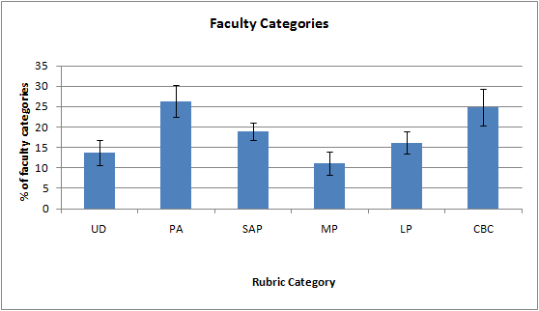
Faculty Category Artifacts Rubric Category
25.0%
- It’s somewhat more difficult to classify overall categories

Slide 8
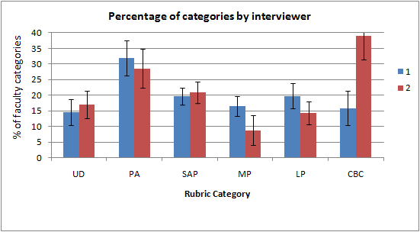
Faculty Category Artifacts Per Interviewer
Discrepancy in faculty categories between interviewers (CBC, maybe MP)
This is independent of institution type (not a result of skewing)

Slide 9
Faculty Category Artifacts Per Interviewer
Preliminary thoughts (a few transcripts): possibly different interviewer interpretations of artifacts as they write them
Rubric effectiveness on categories might depend on interviewer’s style, even though rubric effectiveness on individual artifacts doesn’t

Slide 10
Faculty Category Artifacts Per Interviewer
Interviewer 1: focus on short, individual phrases; directs faculty more
I1: “Just tell me the names [of things you would recommend for students to do while problem solving].” F5: “Well, one of the things is definitely drawing a picture. I think that’s… if not drawing at least have a mental picture in mind. … I think another piece… is identifying the tools that you’re going to use to solve this thing. And by that I mean is it a conservation of energy, is it uniform circular motion… ”
4 artifacts

Slide 11
Faculty Category Artifacts Per Interviewer
Interviewer 2: focus on longer phrases, and maybe paraphrase for writing artifacts
F6: “And I don’t think [problem solving is] something that happens overnight, I think it’s something that has to develop through the years. I2: “Ok.” F6: “Once in a while we’ll spend one whole hour on just a problem and investigating. That happens. And then we have dead ends…” I2: “Anything else?” F6: “Problem solving is again not something that you learn overnight. And I tell them that it’s something that has to be developed…” I2: “Ok.”
Only 2 artifacts in here

Slide 12
Conclusions (for now)
Rubric categories have excellent fit to individual artifacts, very good fit to faculty categories
Faculty focus more on physical principle-related topics (PA and SAP)
-> Consistency of categorizing individual artifacts (faculty categories vs. our use of student rubric)
Rubric data: Interview style doesn’t affect individual artifacts, but does affect faculty categorization of said artifacts

Slide 13
Thanks!
Thanks to K. Heller for advice
Thanks to NSF for funding previous studies
My poster: Tonight (PST2B-32 – not in program)
For more information visit http://groups.physics.umn.edu/physed/

Slide 14
Table of Contents
Background
Faculty Perceptions of Student Problem Solving¹
Rubric for Student Problem Solutions²
Why are we looking at these two together?
Analysis
Artifact categorization activity
How to analyze it?
Results
Classification of index cards, chosen categories
Future work
¹Yerushalmi et al. 2007, Henderson et al. 2007
²Docktor 2009

Slide 15
Faculty Interviews about Problem Solving (Yerushalmi, Henderson et al. 2007)
Purpose: to find out what instructors believe and value about teaching and learning problem solving
Concept map models illustrate what faculty are looking for
Can inform curriculum developers so that they can be consistent with instructor beliefs

Slide 16
Faculty Interviews (Yerushalmi, Henderson et al. 2007)
Interviews carried out with 30 faculty
different representation: Community Colleges (CC), Private Colleges (PC), State Universities (SU), Research University (RU)
2 interviewers – method consistent
Participants studied problem statements, student artifacts and faculty artifacts
Generated their own artifacts, i.e. conversation topics
Then categorized their own artifacts as the last task
This is the task we are interested in

Slide 17
Rubric for Analysis of Problem Solving (Docktor 2009)
Focus: minimum set of problem solving categories by which a written problem solution may be evaluated
Validity, inter-rater reliability have been tested
Five such categories:
Useful Description (UD)
Physics Approach (PA)
Specific Application of Physics (SAP)
Mathematical Procedures (MP)
Logical Progression (LP)

Slide 18
Valid Use of Rubric?
Can see how many artifacts can fit in each given category
Rubric is meant for problem solving - can we interpret faculty artifacts with it?
Interviews focused on problem solving
If at least the individual cards, and possibly faculty categories, can mostly fit into rubric categories, then tool is valid

Slide 19
Results: Individual Faculty Artifacts
2.5% of individual faculty artifacts don’t fit into at least one rubric category (meaning 97.5% do)
Examples that don’t fit: confidence, very vague ideas
Individual category focus
PA has the highest percentage overall
UD and SAP are second most
MP and LP are focused on but not as much as the other three

Slide 20
Individual Faculty Artifacts Institution Type
- RU professors focus more heavily on PA, less heavily on UD and MP
- Other institutions seem to focus roughly the same way on all categories, although PC and SU differ slightly in UD, LP

Slide 21
Faculty Category Artifacts Institution Type
- RU categories focus more heavily on PA and SAP, none for MP
- SU categories also focus heavily on PA, a bit more on UD
- CC, PC are similar

Slide 22
Analysis Procedure: Categorization Task
2 raters use rubric for categorization
Establish inter-rater reliability using sample of 5 faculty distributed evenly across SU, PC, and CC
Split the other 25, random selection, and categorize
Agreement established with discussion
Do this for individual artifact cards and then faculty-chosen categories

Slide 23
Present and Future Work
10 interviews sampled for context
Taken from beginning, middle and end of interview period
Even sampling from different interviewers, institutions
All references to cards, categories marked down via Ctrl+F
How to evaluate qualitative difference between items?
How to relate categories to individual cards?

Slide 24
Present and Future Work
Need to consider context of interviews
Faculty categories can’t be matched as well as individual cards can – any further insight?
Interviewers interpreting categories differently – affects ability to analyze
How to treat possible qualitative difference between value of artifacts?
e.g. overall principle vs. comment on student solution

