Slide 1
Mapping a Problem Solving Rubric to Faculty Perceptions
Andrew J. Mason¹, Brita Nellermoe^{1,2}
¹Physics Education Research and Development
University of Minnesota, Twin Cities, Minneapolis, MN
²University of St. Thomas, St. Paul, MN
MAAPT-WAPT Joint Meeting
October 29-30, 2010

Slide 2
Table of Contents
Background
Faculty Perceptions of Student Problem Solving¹
Rubric for Student Problem Solutions²
Why are we looking at these two together?
Analysis
Artifact categorization activity
How to analyze it?
Results
Classification of index cards
Classification of chosen categories
Future work
¹Yerushalmi et al. 2007, Henderson et al. 2007
²Docktor 2009

Slide 3
Faculty Interviews about Problem Solving (Yerushalmi, Henderson et al. 2007)
Purpose: to find out what instructors believe and value about teaching and learning problem solving
Concept map models illustrate what faculty are looking for
Can inform curriculum developers so that they can be consistent with instructor beliefs

Slide 4
Faculty Interviews (Yerushalmi, Henderson et al. 2007)
Interviews carried out with 30 faculty
different representation: Community Colleges (CC), Private Colleges (PC), State Universities (SU), Research University (RU)
2 interviewers – method consistent
Participants studied problem statements, student artifacts and faculty artifacts
Generated their own artifacts, i.e. conversation topics
Then categorized their own artifacts as the last task
This is the task we are interested in

Slide 5
Rubric for Analysis of Problem Solving (Docktor 2009)
Focus: minimum set of problem solving categories by which a written problem solution may be evaluated
Validity, inter-rater reliability have been tested
Five such categories:
Useful Description (UD)
Physics Approach (PA)
Specific Application of Physics (SAP)
Mathematical Procedures (MP)
Logical Progression (LP)

Slide 6
What are we trying to do?
Rubric categories can be used to examine beliefs and values expressed by faculty in interviews
Research Questions:
Is it valid to use the rubric, and if so, how?
What does the rubric tell us about individual cards and categories?
Future: How can we weigh context of individual cards and categories?

Slide 7
Valid Use of Rubric?
Can see how many artifacts can fit in each given category
Rubric is meant for problem solving - can we interpret faculty artifacts with it?
Interviews focused on problem solving
If at least the individual cards, and possibly faculty categories, can mostly fit into rubric categories, then tool is valid

Slide 8
Analysis Procedure: Categorization Task
2 raters use rubric for categorization
Establish inter-rater reliability using sample of 5 faculty distributed evenly across SU, PC, and CC
Split the other 25, random selection, and categorize
Agreement established with discussion
Do this for individual artifact cards and then faculty-chosen categories

Slide 9
Analysis Procedure: Categorization Task
Things to look at:
Overall category performance, all 30 faculty
Institution type
Interviewer check

Slide 10
Results: Individual Faculty Artifacts

Slide 11
Results: Individual Faculty Artifacts
2.5% of individual faculty artifacts don’t fit into at least one rubric category (meaning 97.5% do)
Examples that don’t fit: confidence, very vague ideas
Individual category focus
PA has the highest percentage overall
UD and SAP are second most
MP and LP are focused on but not as much as the other three

Slide 12
Results: Individual Faculty Artifacts
- RU professors focus more heavily on PA, less heavily on UD and MP
- Other institutions seem to focus roughly the same way on all categories, although PC tends to focus a bit more on LP and a bit less on UD

Slide 13
Results: Individual Faculty Artifacts
Inst. Type | Int. 1 # | Int. 2 #
CC | 5 | 2
PC | 4 | 5
RU | 1 | 5
SU | 4 | 4
Groups are mostly evenly balanced by interviewer
Only bit of difference seems to result from RU skewing (PA)

Slide 14
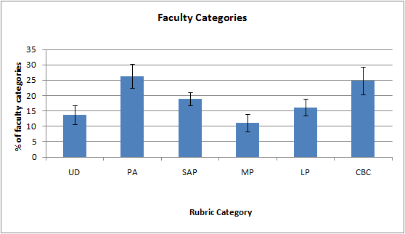
Results: Faculty Category Artifacts
- It’s somewhat more difficult to classify overall categories

Slide 15
Results: Faculty Category Artifacts
- RU categories focus more heavily on PA and SAP, none for MP
- SU categories also focus heavily on PA, a bit more on UD
- CC, PC are similar

Slide 16
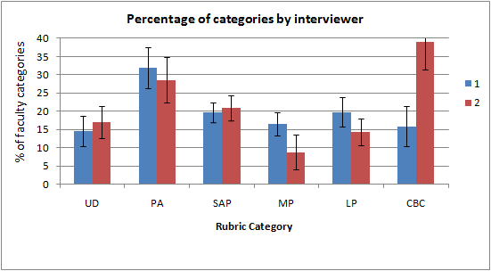
Results: Faculty Category Artifacts
Discrepancy in faculty categories between interviewers (CBC vs. MP)
This is independent of institution type (not a result of skewing)

Slide 17
Present and Future Work
Need to consider context of interviews
Faculty categories can’t be matched as well as individual cards can – any further insight?
Are interviewers interpreting categories differently?
How to treat possible qualitative difference between value of artifacts?
e.g. overall principle vs. comment on student solution

Slide 18
Present and Future Work
10 interviews sampled for context
Taken from beginning, middle and end of interview period
Even sampling from different interviewers, institutions
All references to cards, categories marked down via Ctrl+F
How to evaluate qualitative difference between items?
How to relate categories to individual cards?

Slide 19
Thanks!
For more information visit http://groups.physics.umn.edu/physed/

