Slide 1
Internet coaches for problem-solving in introductory physics: Usability, Usefulness and Design
Presented by: Evan Frodermann¹
Qing (Xu) Ryan¹, Ken Heller¹, Leon Hsu¹, Jia-Ling Lin¹,
Bijaya Aryal²
1.University of Minnesota–Twin Cities
2.University of Minnesota–Rochester
WAPT Fall 2013 Meeting
Eau Claire, Wisconsin
Supported by NSF DUE #0715615 and DUE-1226197.
and by the University of Minnesota

Slide 2
Shameless Plug
National AAPT 2014 Summer Meeting
July 26-30, 2014
University of Minnesota – Twin Cities
Minneapolis, MN
More coaches (and possible workshop)

Slide 3
What are the computer coaches?
Version 1 – Online Computer software which coach students in expert-like behavior in physics problem solving.
3 different types
Type 1: Computer coaches student for full problem.
Type 2: Student coaches computer, computer gives feedback
Type 3: The computer only coaches where students request coaching.
Version 2 – In-development.
This study focuses on version 1 data.

Slide 4
Design components
Software Framework: “Intelligent” Tutors
Pedagogy Framework:
Cognitive Apprenticeship
Modeling
Coaching
Fading
Scaffolding
Research Basis:
Expert & Novices differences in problem solving
Problem solving framework:
Competent Problem Solver – K & P Heller; University of Minnesota
Notes:
The Intelligence is supplied by our research knowledge of problem-solving..
Cognitive apprenticeship model is known to be effective in teaching complex skills such as Problem-solving. And these computer coaches are built within a cognitive apprenticeship model With Coaching strongly emphasized in that students get real-time feedback and guidance while they work through a coached problem.
Also, We know that expert and novices differed in problem solving : Experts tend to use a systematic framework while approaching a problem. And such framework is incorporated into our computer coaches.

Slide 5
Design Process Cycle
Prototypes
Assessment
Usage & Usability
Large-scale Implementation
Notes:
Designing such computer coaches, Like the design of anything else, is not a linear process. One may go through several stages of Building prototypes, Implementation, and Assessment until the framework is mature and effective.
Right now, we have these prototypes built based on past research. These prototypes are 35 coached problem spanning 6 topics in Intro. mechanics. And Had implemented on large-scale in Fall 2011 and Spring 2013.

Slide 6
Usage, Usefulness and Design Studies
Who will naturally use such coaches?
subpopulation characteristics
How do students use them?
usage characteristics
Do the students perceive them as useful?
Do the coaches improve student problem solving?
How to use this information to guide future development of the next version?
Notes:
Size of user population and their characteristics

Slide 7
Implementation tests
35 coached problems
2 sections of calculus-based introductory mechanics course
Spring 2013 (148 students/103 students).
Homework with WebAssign.net
Various problem had available computer coaches
Data collected includes:
Pre/post-test scores (FCI/Math/CLASS)
13 written problem solutions from 4 midterms (2 problems each) and a final exam (5 problems)
Two surveys of student opinions regarding the coaches (mid & end semester)
Keystrokes data monitoring students’ use
No specific credit for using the coaches

Slide 8
User Characteristics
3 User populations (m:male; f:female)
H group (heavy user): 80-100% (n_{H}=49 (20% of N), 65%m,35%f)
M group (medium user) : 40-60% (n_{M}=38 (15% of N), 55%m,45%f)
L group (Light/Non user) : 0-20% (n_{L}=72 (29% of N), 85%m,15%f)
Entire class (N=251, 70%m,30%f)
Notes:
Noticing that we subtracted out people in the between th 60-80% and 20-40% to get Non-overlapping populations.
One thing you may have noticed is that the female is the L group is 15%...

Slide 9
Expectations of the class
L group: Expects A grade, study less
M group: Expects A grade, study more
H group: Expects B grade, study more
Typical average grade in the course is B/B-
Notes:
One might thus infer that students in the L group have high confidence in their ability to perform well. Students in the M group similarly expect to do well, but also expect to spend more time doing so. Students in the H group expect to spend more time and are less confident of their success.
• females are underrepresented in L group (15%)
class as a whole (30%)
• A higher FCI pre-test score is correlated with lower usage.
• L group expect to spend less time studying & high grade
• H students expect to spend more time and are less confident of their success.

Slide 10
Pre-class FCI & Gender
Test | L (N=48) |  | M (N=27) |  | H (N=35)
 | Male | Female | Male | Female | Male | Female
 | 85% | 15% | 67% | 33% | 66% | 34%
FCI | 58%±3% | 59%±11% | 53%±5% | 42%±7% | 46%±3% | 31%±3%
MATH | 57%±3% | 66%±8% | 53%±4% | 61%±7% | 54%±4% | 45%±4%
CLASS | 62%±3% | 55%±6% | 66%±3% | 66%±5% | 65%±3% | 56%±4%
Total PreFCI: L: 58%±3% M:49%±4% H:41%±3%
The gender, pre class FCI scores, expected study time and expected grade will serve as the primary identifiers of these usage patterns.
Notes:
One might infer that the more poorly prepared students recognize this and choose to use easily accessible help.
• females are underrepresented in L group (15%)
class as a whole (30%)
• A higher FCI pre-test score is correlated with lower usage.
• L group expect to spend less time studying & high grade
• H students expect to spend more time and are less confident of their success.

Slide 11
Did the students improve? Final exam scores
Final Exam | M | F | Total
H (N=49) | 72.8 ± 2.0 | 67.5 ± 4.1 | 71.0 ± 1.9
M (N=38) | 64.8 ± 3.5 | 68.3 ± 4.4 | 66.4 ± 2.7
L (N=72) | 69.2 ± 2.7 | 70.9 ± 6.2 | 69.5 ± 2.5
Heavy users ≈ Light users in final exam
However, the confidence and FCI score of the students started lower.
Need to examine this closer.

Slide 12
Matching Historical Data
Matched similar students to the Spring 2013 coach user class.
Match on pre-class FCI, gender, expected grade, and expected study time.
~85% student perfect match. 3145 students from Spring 2009 to Fall 2011.
Allowed FCI difference of 2 for the remaining baseline.
Normalize the exam scores and vary the selection process.
Reduce unintended selection bias or specific class bias into the results.
Retained the exam distributions.

Slide 13
Matched Final Exam Scores
 | Fall → Spring | Spring → Fall | Spring 2013
Matched L (N=48) | 71.9% ± 1.4% | 71.6% ± 1.5% | 70.3% ± 3.0%
Matched M (N=27) | 68.2% ± 1.9% | 69.3% ± 2.0% | 66.1% ± 3.1%
Matched H (N=35) | 61.4% ± 1.6% | 62.3% ± 1.6% | 69.9% ± 2.6%
Only students with FCI scores were considered.
Lower overall statistics in Spring 2013
Increased baseline to compensate by matching 4 students to Spring 2013.
Still a 85% “perfect match” with 4 to 1 match.

Slide 14
Motivation for future coach design
Selected data from survey, End-term Spring 2013
The computer coaches did not help improve my problem solving in this class. (135 responses)
Selected data from survey, Midterm Spring 2013
Free response: What do you like least about the computer coaches?
“Too repetitive” or “too long”: 49% of the 183 responses
30 minutes
Free response: What do you like most about the computer coaches?
“Step by step” or “Guide beginning to end”: 23% of the responses.
Both free response categories were the most frequent.
 | Not Improve | Neither | Improve
H (65) | 21% | 12% | 67%
M (27) | 11% | 15% | 74%
L (43) | 34% | 24% | 41%
H: Heavy User (80-100%)
M: Medium User (40-60%)
L: Light user (0-20%)
Notes:
Some of the student feedback is from the surveys in Fall 2011 and Spring 2013.
Question from end term survey
Most students disagreed that the coaches did NOT help their problem solving in the class.
There seems to be need for these types of online coaches in problem solving based introductory physics class.
Free response questions from midterm Spring 2013
What do you like least about the computer coaches?
Too repetitive or too long were 49% of the responses.
What do you like most about the computer coaches?
Step by step or guide from beginning to end were 23% of the responses.
There seems to be a desire to streamline our coaches to shorten the time it takes.
Must be done in a way to not remove the desire for step by step guides through problems.
Must be done in a way that retains the problem solving pedagogy of the instructor.

Slide 15
Student Flexibility
Transparent student dictated solution paths.
Students are free to finish any part of the “unlocked” coach at any point.
More “human-like” coaching;
This is accomplished due to a shift towards object-oriented programming
Student adjusted grain size
Previous version either forced students into completing steps they may not need or did not give full detailed guide even if they desired.
Areas of the coaches are streamlined to reduce repetition
More detail can be accessed if desired to retain the “step-by-step” nature of the coaches.
Notes:
We have a framework which is more flexible than version 1 which adapts more of the problem solving pedagogy we would like to see in our online coaches.
Solution paths are open.
Students can choose to solve any unlocked path. How much is unlocked at a given time or from a given question is dictated by the instructor.
Going to more human-like coaching.
Students aren’t immediately locked into a particular choice
Adjustable grain size
Students work on problems on their own and turn to coaches for assistance.
Some V1 coaches forced the students to start from the beginning regardless of previous progress in the coach or outside of the coach.
Some v1 coaches forced the student to have a near complete idea of the problem and brought them into a specific area of issue when prompted.
There is no middle ground. The new version will bridge the gap by having adjustable grain sizes.

Slide 16
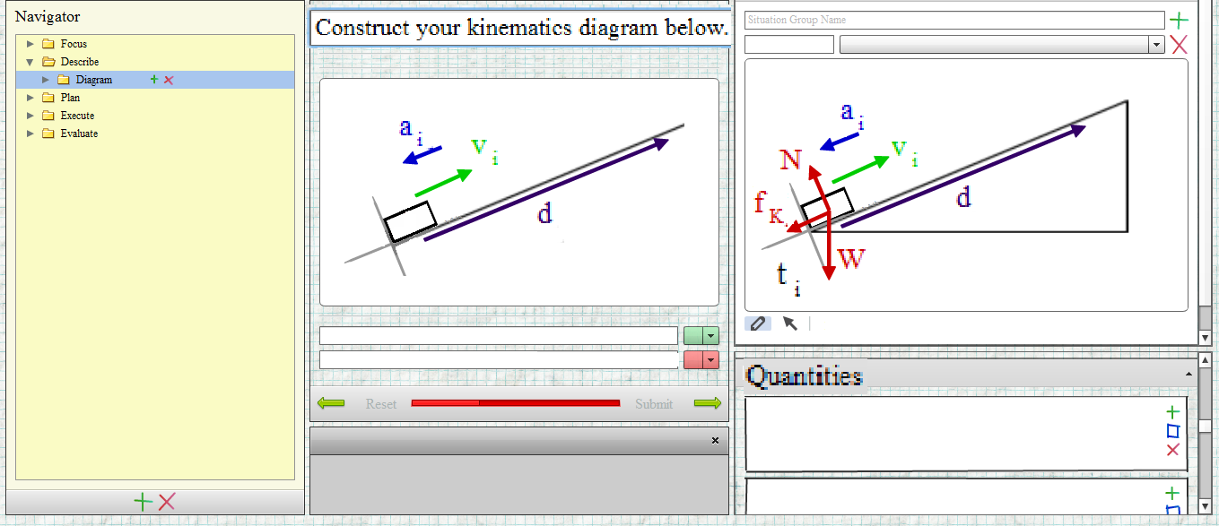
Instructor Flexibility
The individual elements of the coach are easier to edit.
No flash programming needed. Everything is edited in a graphical interface.
Instructors can choose to add or remove forces, add objects, change colors, shapes, etc. to their diagrams based on their own structure. (ie, choose own pedagogy)
Picture elements are added to the database through the interface menus.
Diagrams are constructed by dragging elements from the picture into the diagram box.
Instructors edit pictures and diagrams within the GUI.
Notes:
To improve the instructor flexibility with using the program is associated with how the actual elements acted in version 1.
Previously, if variable names, colors, elements (do you want Earth as part of your picture) were not what was desired by the instructor, it was difficult to change.
Required flash programming
We now allow this flexibility with version 2.
Example: Pictures and diagrams are created and edited within the GUI.
Elements are added through the interface.
All pictures can be changed to cater to the instructor’s needs

Slide 17
Summary
A significant number of students use the coaches.
Female, less-prepared students, and students with less-confidence tend to use the coaches.
Different usage patterns.
These identified usage patterns have indications that coaches may improve problem solving.
Need more coached student data.
FCI gains for both groups. (FCI gain for Spring 2013 done)
Correlation between TA grades and Expert rubric assessment.
Compare baseline with two different coach implementation.
Version 2 is being developed which improves flexibility for instructor and student.
Notes:
Subpopulation
M _address perceived inefficiency
H _step by step if desired; encourage bypassing detailed coaching

Slide 18
Backup Slides
Version 1 data

Slide 19
FCI post and gain
Heavy users absolute gain is higher.
We expect to see specific gains in problem solving aspects which isn’t addressed with this diagnostic tool.
${\left\langle g\right\rangle }_{H}= 0.345$, ${\left\langle g\right\rangle }_{M}= 0.378{, \left\langle g\right\rangle }_{L}=0.292$

Slide 20
User approach
Notes:
The top statement “….” is the main mode for the Medium users, selected by 70% of them.
The second statement “,,,,” ,

Slide 21
Forced ranking
Rank the components of the physics class in order from the most useful (10) to least useful (1) to your learning. Do not use any ties.
Top 3: Lectures, homework, Computer coaches (High & Medium Users)
ahead of textbook, labs, and problem-solving discussion sections
Lectures, Discussion, Labs, Computer coaches, Text book, Tutor room, Doing the homework, Clicker questions, The Competent Problem solver, Feedback from WebAssign
(in the order that was given on the survey)
Notes:
1,7,2,8,4,3,5,6,9,10

Slide 22
End-semester survey
A: Strongly agree B: Agree C: Neither D: Disagree E: Strongly disagree
 | A or B | Neither | D or E
H | 21% | 12% | 67%
M | 11% | 15% | 74%
L | 34% | 24% | 41%

Slide 23
End-semester survey
A: Strongly agree B: Agree C: Neither D: Disagree E: Strongly disagree
 | A or B | Neither | D or E
H | 70% | 12% | 19%
M | 63% | 33% | 4%
L | 45% | 28% | 28%
Notes:
Summarize % of each choice

Slide 24
End-semester survey
A: Strongly agree B: Agree C: Neither D: Disagree E: Strongly disagree
 | A or B | Neither | D or E
H | 70% | 14% | 16%
M | 70% | 26% | 4%
L | 47% | 28% | 26%

Slide 25
Developing version 2
Better address the needs of the H and M user population
H_ encourage bypassing detailed coaching
M_ adjust decision grain sizes
Notes:
Subpopulation
M _address perceived inefficiency
H _step by step if desired; encourage bypassing detailed coaching

Slide 26
Backup Slides
Version 2 talk from AAPT

Slide 27
Developing a Framework for Problem Solving Computer Coaches
Presenter: Evan Frodermann
University of Minnesota – Twin Cities
Collaborators: Qing (Xu) Ryan, Kristin Crouse,
Ken Heller, Leon Hsu, Jia-ling Lin, Bijaya Aryal
AAPT Summer 2013 Meeting
Portland, Oregon

Slide 28
From Version 1 (v1) to Version 2 (v2)
What do we want to retain?
Cognitive apprenticeship framework
Modeling, Coaching, Fading, Scaffolding
What do we want to improve?
A more flexible framework in which to build coaches.
Remove some of the technological limitations of the previous version.
We used instructor and student feedback to improve the design and structure of the coaches.
Notes:
We want to retain some fundamental features.
Microcosm of the overall problem solving structure of the course mimicked in the online coaches.
Not stand alone. These are intended to be a part of a full course with a course.
We want to improve them as well.
Modern intelligent tutors. We are using our knowledge of students and teaching from our previous extensive research in problem solving and molding our online coaches around these studies.
Not very intelligent as they don’t adapt to the students needs on demand. A more flexible framework will allow this to be true.

Slide 29
Motivation from Student Responses
Selected data from survey, End-term Spring 2013
The computer coaches did not help improve my problem solving in this class. (135 responses)
Selected data from survey, Midterm Spring 2013
Free response: What do you like least about the computer coaches?
“Too repetitive” or “too long”: 49% of the 183 responses
30 minutes
Free response: What do you like most about the computer coaches?
“Step by step” or “Guide beginning to end”: 23% of the responses.
Both free response categories were the most frequent.
 | Not Improve | Neither | Improve
H (65) | 21% | 12% | 67%
M (27) | 11% | 15% | 74%
L (43) | 34% | 24% | 41%
H: Heavy User (80-100%)
M: Medium User (40-60%)
L: Light user (0-20%)
Notes:
Some of the student feedback is from the surveys in Fall 2011 and Spring 2013.
Question from end term survey
Most students disagreed that the coaches did NOT help their problem solving in the class.
There seems to be need for these types of online coaches in problem solving based introductory physics class.
Free response questions from midterm Spring 2013
What do you like least about the computer coaches?
Too repetitive or too long were 49% of the responses.
What do you like most about the computer coaches?
Step by step or guide from beginning to end were 23% of the responses.
There seems to be a desire to streamline our coaches to shorten the time it takes.
Must be done in a way to not remove the desire for step by step guides through problems.
Must be done in a way that retains the problem solving pedagogy of the instructor.

Slide 30
Developing version 2
Better address the needs of the Heavy and Medium user population (Qing’s Talk)
H: encourage bypassing detailed coaching
M: adjust decision grain sizes
Notes:
Subpopulation
M _address perceived inefficiency
H _step by step if desired; encourage bypassing detailed coaching

Slide 31
Student Flexibility
Transparent student dictated solution paths.
Students are free to finish any part of the “unlocked” coach at any point.
More “human-like” coaching;
This is accomplished due to a shift towards object-oriented programming
Student adjusted grain size
Previous version either forced students into completing steps they may not need or did not give full detailed guide even if they desired.
Areas of the coaches are streamlined to reduce repetition
More detail can be accessed if desired to retain the “step-by-step” nature of the coaches.
Notes:
We have a framework which is more flexible than version 1 which adapts more of the problem solving pedagogy we would like to see in our online coaches.
Solution paths are open.
Students can choose to solve any unlocked path. How much is unlocked at a given time or from a given question is dictated by the instructor.
Going to more human-like coaching.
Students aren’t immediately locked into a particular choice
Adjustable grain size
Students work on problems on their own and turn to coaches for assistance.
Some V1 coaches forced the students to start from the beginning regardless of previous progress in the coach or outside of the coach.
Some v1 coaches forced the student to have a near complete idea of the problem and brought them into a specific area of issue when prompted.
There is no middle ground. The new version will bridge the gap by having adjustable grain sizes.

Slide 32
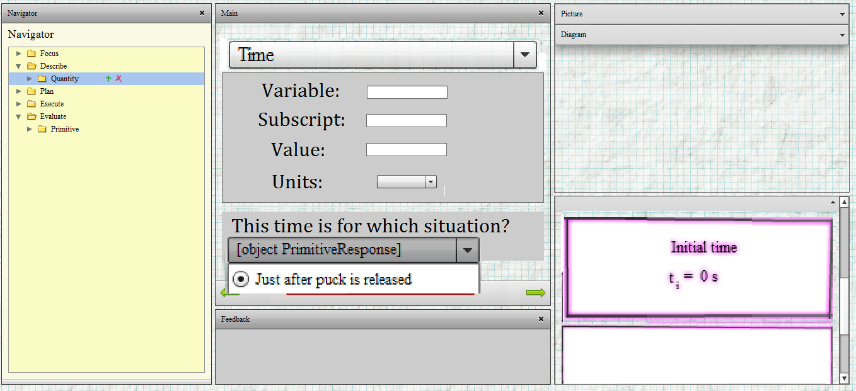
Grain-size with Quantity Module
The quantity module is a small example of this “grain size”.
Students choose which ones to define. Only minimal set required.
More quantities (specifically those associated with other solution paths) can be defined depending on what students want to define.
Quantity categories are defined by instructor which include a list of required responses.
Quantities required to solve the problem must be defined. Other quantities can also be defined.
Students choose which quantities to define with these minimal responses.
Notes:
Example of adjustable grain sizes to reduce repetition
Quantity module.
Quantities are defined at once (or in chunks). Students choose which quantities to “unlock”. Only the minimal set for their solution is required.
Each solution path will have different quantity requirements.
Students choose what variables to use (and definitions) which connects closer to their own preferences.

Slide 33
Instructor Flexibility
The individual elements of the coach are easier to edit.
No flash programming needed. Everything is edited in a graphical interface.
Instructors can choose to add or remove forces, add objects, change colors, shapes, etc. to their diagrams based on their own structure.
Picture elements are added to the database through the interface menus.
Diagrams are constructed by dragging elements from the picture into the diagram box.
Instructors edit pictures and diagrams within the GUI.
Notes:
To improve the instructor flexibility with using the program is associated with how the actual elements acted in version 1.
Previously, if variable names, colors, elements (do you want Earth as part of your picture) were not what was desired by the instructor, it was difficult to change.
Required flash programming
We now allow this flexibility with version 2.
Example: Pictures and diagrams are created and edited within the GUI.
Elements are added through the interface.
All pictures can be changed to cater to the instructor’s needs

Slide 34
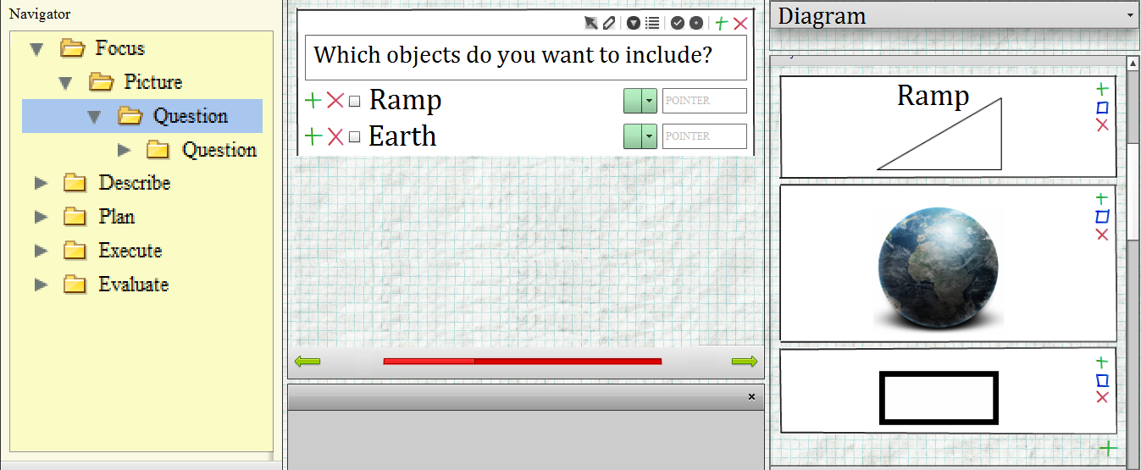
Problem Solving Philosophy
Previously, pedagogical changes/rewrites amounts to completely rewriting the software.
The instructors can adapt the coach solving structure using the graphical interface to fit the needs of their own course.
Users navigate to different “parent” elements at any time through this menu.
“Primitive” elements are unlocked for the student after correct responses.
“Children” elements are only unlocked for the student with correct responses to questions.
Notes:
Beyond just changing elements of the coach which is possible with a lot of effort, changing the structure of the coach was impossible.
The GUI in version 2 allows the instructor to tailor the coaches to their own needs.
The prebuilt coaches will follow this model, but they will not be locked to this structure.

Slide 35
Conclusions
Version 1 coaches had some limitations.
Version 2 is far more versatile.
Flexible for students with adjusting grain sizes.
Transparent freedom of choice.
More human-like coaching
Adaptable to an instructor’s individual courses.
Future work.
Develop coaches for calculus based electromagnetism course.
Explore overall usefulness for the identified populations,
More in Qing’s talk about the ID’ed population.
A new interface not using Flash (version 3 and beyond) for more general use on tablet computers.

Slide 36
Thanks
For a demonstration of portions of the new version of the online coaches, visit the Wednesday poster session, poster number PST2C10.
Qing’s poster on usage data is PST2C14
Supported in part by National Science Foundation, DUE-1226197 and the University of MN

Slide 37
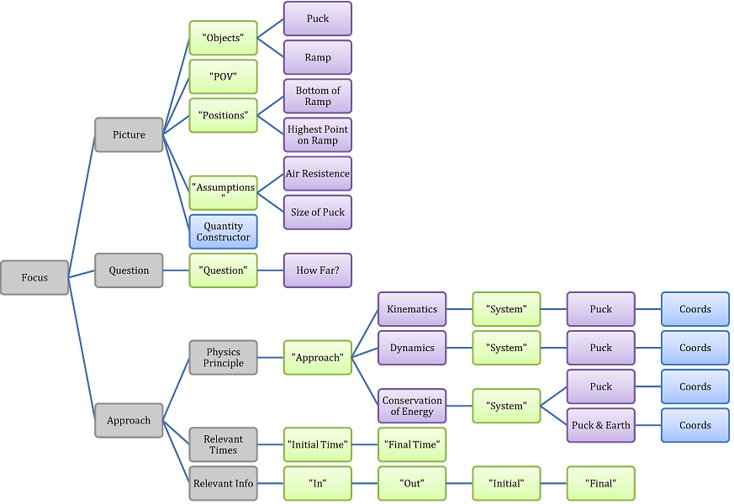
General Coach Design
Our coaches follow the Minnesota model for problem solving.
Pictured is just the “focus” part of the process.
Other instructors are not locked to this model and may adjust coaches how they see fit.

Slide 38
Program Design
Clients
Instructor
Server Host
Adobe Flash Player and internet connection
Java Web server
Apache Tomcat
MySQL database
Students
Version 1 required programming knowledge.
Difficult editing or changing of existing coaches.
New graphical user interface (GUI) designed to construct coaches.
Backend data stored in SQL database and accessed through Java web server. (Free software)
Clients access the java client through Adobe Flash. (Free software)
Notes:
How do we increase the flexibility of the design.
We need to know how inflexible the version 1 coaches were.
Needed to know xml and flash programming elements in order to create or edit existing coaches. Very rigid in design.
How do we get around this?
Developed a graphical user interface (GUI) in order to design coaches.
In essence, leave the dirty programming to us, instructors just develop coaches.
All coaches are stored in a SQL database and accessed through a Java web server.
Instructors and students access the java web server using the flashplayer frontend GUI.
One thing to note, all of this stuff is free.

Slide 39
Program Structure Layout
General terms.
“Parent” and “Children” elements
Logic for solving the problems
“Primitive” elements
Anything you would naturally write for a paper solution of a physics problem.
Coordinate system, approach, picture, diagrams, etc.
Students unlock elements by answering questions in the problem solving process.
Notes:
We not only want to improve the flexibility of the base computer science elements of the program but we want to improve the flexibility of the coaches themselves.
We moved towards object oriented programming.
Because of this I want to list some terms that we use to describe some objects in our coaches.
Parent and Children
This is computer science term we adopted. It essentially describes the logic of the problem solving in the coaches. Children are not accessible unless the parent allows it. All of the posed questions to guide students will follow this parent/children structure.
Primitives
These elements describe every part of the solution that you would naturally find on a paper solution of a problem.
Every detail. Coordinate system, equations, mathematical steps, quantity definitions, pictures, diagrams etc.
Students will unlock primitive elements by answering questions within the parent/children logical structure of the problem

